Slide 1


Smoggy-Link: Fingerprinting Interference for Predictable Wireless Concurrency
Meng Jin¹, Yuan He², Xiaolong Zheng², Dingyi Fang¹, Dan Xu¹, Tianzhang Xing¹, Xiaojiang Chen¹
¹Northwest University
²Tsinghua University
ICNP 2016, Singapore
Notes:
Good afternoon everyone, I’m Meng Jin from Northwest University in Xi’ an, China.
Today, I’m going to show with you our recent work titled “Smoggy-Link: Fingerprinting interference for Predictable Wireless Concurrency”
This is a joint work between Northwest University and TsingHua University.

Slide 2
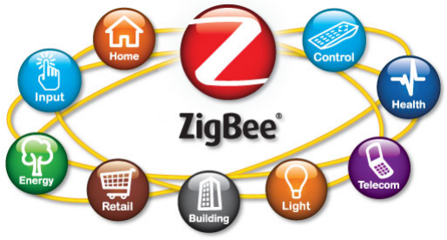
ZigBee Communication
Standard: IEEE 802.15.4
Applications:
Sensor networks; Smart homes; Internet of things; Industrial control; ......
Notes:
ZigBee is a important wireless technology that has draw extensive interests by academic and industry.
It has been widely used in sensor networks, smart homes, industrial control and so on…
However, with the explosive growth of wireless and mobile networks, today’s Zigbee still faces a lot of problems.
One of the most serious problems is cross technology interference.

Slide 3

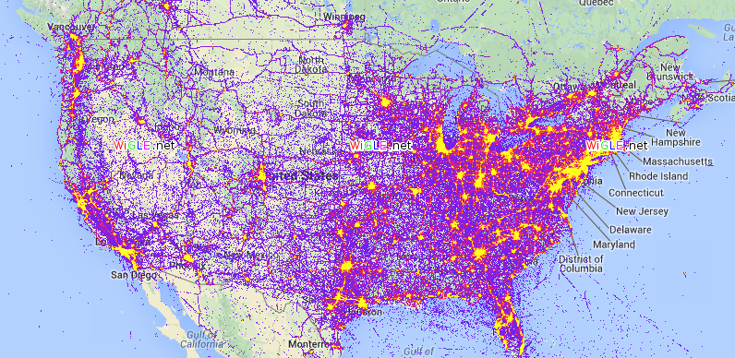
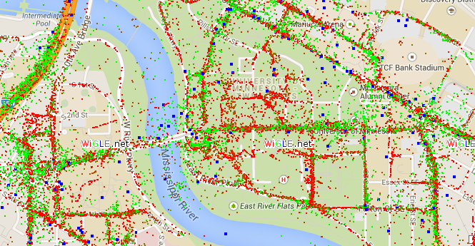


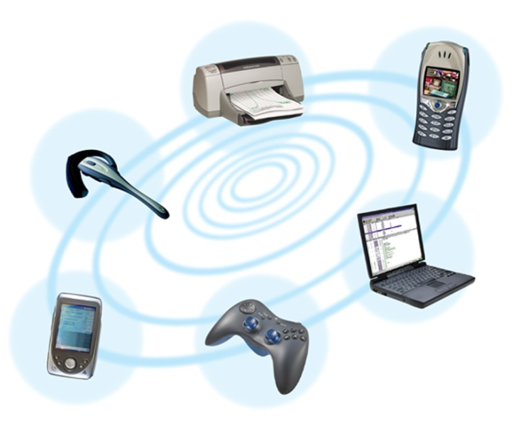
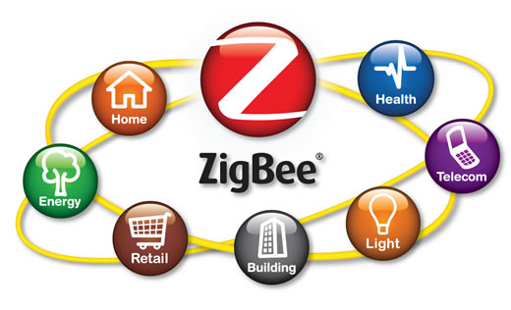

Wireless is Everywhere
Interference
Notes:
As we all know, wireless signal is everywhere.
In addition to ZigBee, Today’s mainstream wireless technology also include WiFi and Bluetooth.
They share the same band and thus lead to severe interference when they transmit concurrently with each other.

Slide 4
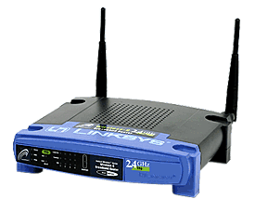
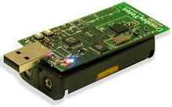
Interference Avoidance?
Time
……
……
……
……
Backoff
Built upon CSMA
Exclusive mode for channel access
With CSMA mechanism, senders transmit data
packets in exclusive mode to avoid interference
Exclusive transmission mode usually results in
long waiting time and low channel utilization.
Notes:
The most common solution today is to avoid the interference based on the CSMA technology.
When a node intends to transmit a packet, it first conducts channel assessment to judge whether the channel is busy.
If the channel is busy, it will perform random backoff to avoid the interference.
This compels different sender to transmit in exclusive mode.
However, such a mode usually results in long waiting time and low channel utilization.

Slide 5

Concurrency
Should different technology transmit data packets
always in exclusive mode?
NO!
Actually, due to exposed terminal phenomenon…
Time
……
……
……
……
Link Selection
Concurrency！
Notes:
So in this work, we ask a question that: should different technology transmit packets always in exclusive mode?
The answer is NO.
Actually, due to exposed terminal phenomenon, there exists many opportunity for a sender to transmit a packet concurrently with the interference.
As shown in this figure, an interference is likely to affect only part of the links, the rest of them are still clear.
So, when faced with the interference, a smarter choice for a sender is to select a good link, so that it can transmit concurrently with the interference.

Slide 6
Smoggy-Link
# Goal: Concurrent transmission with cross-technology interference exploiting exposed terminal
Notes:
Motivated by the above-mentioned opportunities , we propose the design of Smoggy-Link.
The goal of smoggy-link is to enable a zigbee node to transmit concurrently with cross-technology interference by exploiting exposed terminal phenomenon.

Slide 7
Challenges
#1 Find the “good” Link
Link quality is changeable and unpredictable.
Frequent measurement for all the link incurs high energy consumption.
#2 Schedule the Transmission of ACK
Link asymmetry.
ACKs must arrive at the sender between interference frame clusters.
collision
Notes:
Although the basic idea sounds straightforward, two challenges need to be addressed.
The first one is How to find the “good” links:
Considering the dynamic network environment, the link quality is changeable and unpredictable.
Thus, to trace the quality of the links, the node has to conduct frequent measurement for all the links, which however leads to high energy consumption.
The second challenge is How to schedule the transmission of the ACKs.
Its easy to understand that, due to the link asymmetry, although the sender has a chance to transmit a packet successfully under the interference, the ACKs is likely to collide with the interference.
Thus the ACKs should be scheduled to arrive during the idle space of the interference.

Slide 8
Challenges
#1 Find the “good” Link
#2 Schedule the Transmission of ACK
Notes:
First, let’s see how to find the good link.

Slide 9
Interference v.s. Link Quality
How different interference impact ZigBee?
Preliminary Experiment
ZigBee: TelosB mote with TinyOS
Channel 12; 2 Kbps
Interference: WiFi (2~8Mbps), Bluetooth (1~2Mbps)
Notes:
We start with a experiment which shows how different interference impact Zigbee transmission.
We randomly deploy seven nodes in a conference room, where one is the sender and the others are receivers.
In the experiment, the sender periodically broadcasts packets, and the receivers listen and record the sequence numbers of the received packets.
We also set four interferers in the conference room，including two wifi and two bluetooth.
During the experiment, we periodically turn ON each interferer to generate signal.

Slide 10
Interference v.s. Link Quality
Our Observation
Interference ID
Link ID
PRR
Nonuniform distribution
Dynamic
A specific interference is likely to have different effect on different links
PRR for each link is fluctuates with and highly correlated to the interference.
Adaptive link selection based on the ongoing interference.
Simultaneously achieve high throughput and high PRR.
Notes:
The experiment result is shown in this figure.
The figure shows the PRR of different link under different interference.
We can see that a specific interference is likely to have different effect on different links.
Thus there is strong possibility that any one of the receivers can successfully decode the sender’s packet even under an ongoing interference.
Another important observation is that the PRR for each link is not constant and highly correlated to the interference.
So, if a senders can adaptively select the strongest link based on the ongoing interference, it can get ideal throughput and PRR even under the interference.

Slide 11
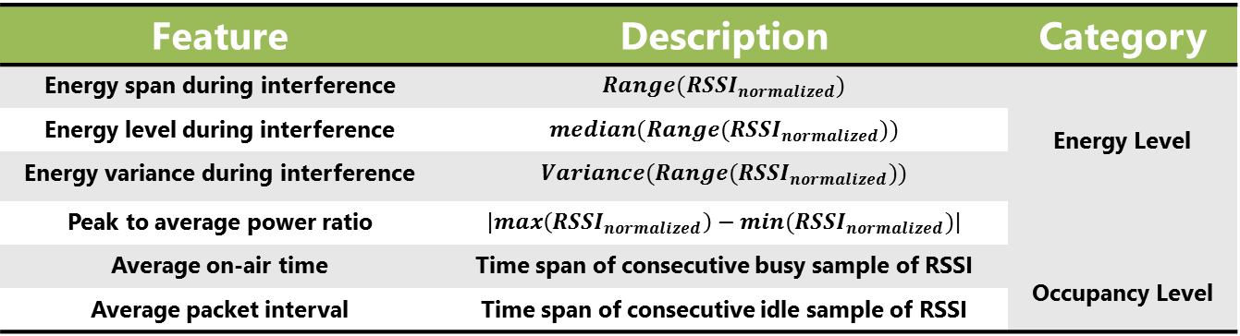
Feasibility of Interference Identification
However, is it possible to identify the ongoing interference?
Feature | Description | Category
Energy span during interference | $$Range({RSSI}_{normalized})$$ | Energy Level
Energy level during interference | $$median(Range({RSSI}_{normalized}))$$
Energy variance during interference | $$Variance(Range({RSSI}_{normalized}))$$
Peak to average power ratio | $$|max\left({RSSI}_{normalized}\right)−min({RSSI}_{normalized})|$$
Average on-air time | Time span of consecutive busy sample of RSSI | Occupancy Level
Average packet interval | Time span of consecutive idle sample of RSSI
Different interferers generate signal with different RSSI patterns
Energy Level
Occupancy Level
A node can get fine-grained link information based on low cost PHY information of the interference
Notes:
However, is it possible to identify different interference?
To answer this question, we conduct another experiment to observe the property of different interferences, and the result is shown in this figure,
We can observe that different interferers would generate signal with different RSSI patterns.
There exist several features in terms of both energy level and occupancy level, that can be leveraged to identify interferences.
This table lists a set of features that are found feasible to distinguish different interferences
Combine the above observation with the result of the last experiment, we can draw a conclusion that: A node can get fine-grained link information based on low cost physical layer information.

Slide 12

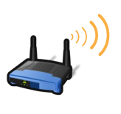
Find the “Good” Link
Interference identification
Link estimation
Feature Extraction
Interference Identification
Link Model
Link Selection
Notes:
Therefore, to find the good link, a sender should first conduct interference identification
And then estimate the link quality based on the identification result.

Slide 13
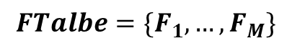
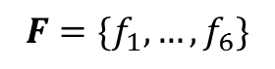
Interference Identification
A node can distinguish different interferences by using their “fingerprint”:
Each interference has a Fingerprint
$$FTalbe=\{F_{1}, …,F_{M}\}$$
$$F=\{f_{1}, …,f_{6}\}$$
Exploit the K-Means clustering to discriminate different interferences based on the cityblock distance between fingerprints
Feature Extraction
Interference Identification
Link Model
Link Selection
Notes:
Now let’s see how to distinguish different interferences.
To do this, the node should first construct a fingerprint for each interference, and store them in a fingerprint table.
The fingerprint can be represented in the form of a feature vector.
When a interference is detected, the sender exploit the K-Means clustring to discriminate different interferences based on the cityblock distance between their fingerprints

Slide 14
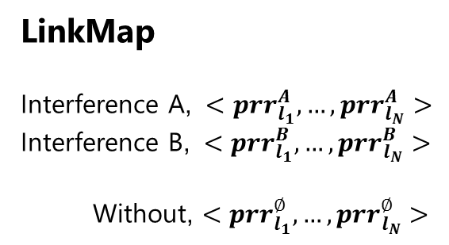
Link Estimation
Translate the interference information to the PRRs of the outbound links
Different Interference
PRR for outbound links
LinkMap
Interference A, $<{prr}_{l_{1}}^{A}, …,{prr}_{l_{N}}^{A}>$
Interference B, $<{prr}_{l_{1}}^{B}, …,{prr}_{l_{N}}^{B}>$
Without, $<{prr}_{l_{1}}^{∅}, …,{prr}_{l_{N}}^{∅}>$
Add to
…
Provide
Construction: Burst probing.
Link Selection: Based on information in LinkMap.
Feature Extraction
Interference Identification
Link Model
Link Selection
Notes:
After identifying the interference, the next target is to translate the interference information to the PRR of the outbound links
To achieve this, each sender constructs a LinkMap to maintain PRRs of its outbound links under different interference.
At the beginning, the LinkMap is empty and thus when a new interference is detected, the sender has to rely on burst probing to measure PRR of the outbound links.
Then the PRR information is added to the LinkMap.
After the LinkMap is constructed, the sender can select the best link based on the interference information and the information in LinkMap.

Slide 15
Challenges
#1 Find the “good” Link
#2 Schedule the Transmission of ACK
Notes:
Then let’s look at how to Schedule the transmission of ACKs.

Slide 16
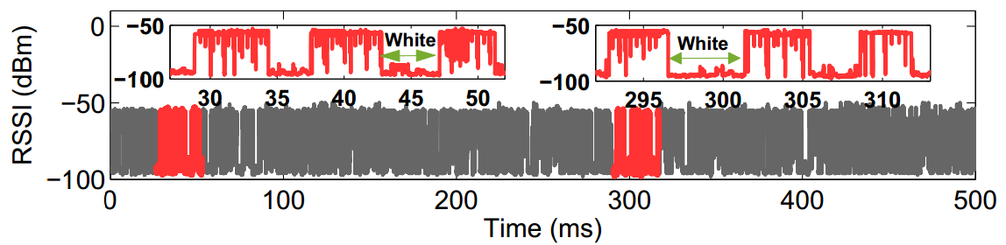
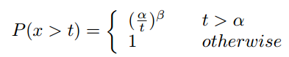
Schedule the Transmission of ACK
ACKs must arrive between interference frame clusters.
Predict the alternating pattern of the white/black space!
black
white
Modeling the white/black space pattern:
Pareto model
Notes:
The ACKs must be scheduled to arrive during the interval between interference frame clusters.
Here we term the interval as white space and the busy period as black space.
To achieve above target, we have to predict the alternating pattern of the white space and black space.
This is feasible only if the distribution of the white and black space is predictable.
Thus we further conduct a experiment to observe the distribution of white and black space.
The result is shown in this figure.
We zoom in two different period of the RSSI sequence and we find that the distribution of white and black space shows a strong self-similarity phenomenon.
Thus we propose to use the Pareto model to fit the distribution of the white and black space.
With this model, we can predict the arriving time and length of white and black space, which is important information for scheduling the transmission of ACKs
When a new interference is detected, the sender samples the channel and estimate the parameter of this interference.
Then the parameters are stored together with the LinkMap.

Slide 17
Schedule the Transmission of ACK
In one white/black period
Limiting the length of data period in the current white/black period
Adjusting the arrive time of the ACK
Notes:
Then we can schedule the transmission of ACK.
Since the ACK should be scheduled to arrive just between two black spaces, not to early and not too late
So, first we should limit the length of the data period, so that the ACK can arrive before the next black space.
In addition, to avoid the collision with the current black space, the sender has to estimate the coming time of the white space.
If it find that the data period is too short, the sender has to notify the receiver to wait a period of time before replying the ACK.
Both the upper limit for the data period and the length of waiting time can be estimated based on the Pareto model.
Smoggy-Link uses one ACK to reply all the data packet transmitted in one white/black period.
It use a 15 bits payload to describe reception of the data packets in the current white and black period,
’1’ indicates failure and ’0’ indicates success.

Slide 18
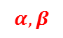
Putting Them Together
update
PRR
$$α, β$$
update
Interference information
Notes:
Now let’s Put them together, to see the workflow of Smoggy-Link
There are three major components in Smoggy-Link: interference identification component, data transmission component and a link estimation component to bridge these two components.
The identification component aims to identify the ongoing interference.
Then the the link estimation component translate the interference information to the link quality information.
Such information can be further used for link selection and transmission schedule.
So this is how smoggy-link works

Slide 19
Evaluation
Evaluation
Implementation:
- TelosB
- TinyOS 2.1.1
Interference
WiFi: Smartphone, iperf
Bluetooth: Smartphone
Compared schemes
Smogy-Link: the proposed design in this paper.
Beacon+CSMA off: transmission method with CSMA enabled using
beacon-based link estimation.
Beacon+CSMA on: transmission method with CSMA enabled using
beacon-based link estimation.
Beacon+WISE^{[1]}: transmission method using beacon-based link
estimation and using WISE for interference avoidance.
[1] Beyond Co-existence: Exploiting WiFi White Space for ZigBee Performance Assurance. ICNP 2010
Notes:
Then, Let’s look at the performance
Smogy-Link is implemented in TinyOS
We select WiFi and Bluetooth as the interference in our experiment.
We compare Smoggy-Link with the transmission techonlogy based on CSMA enabled and disabled,
we also compare smoggy-link with WISE, which enables ZigBee to transmit packets during the white space of the interference

Slide 20
Network Performance
Performance
Throughput
Retransmission
Notes:
We use the same testbed in the initial experiment to evaluate the network performance of Smoggy-Link in terms of throughput and retransmission.

Slide 21
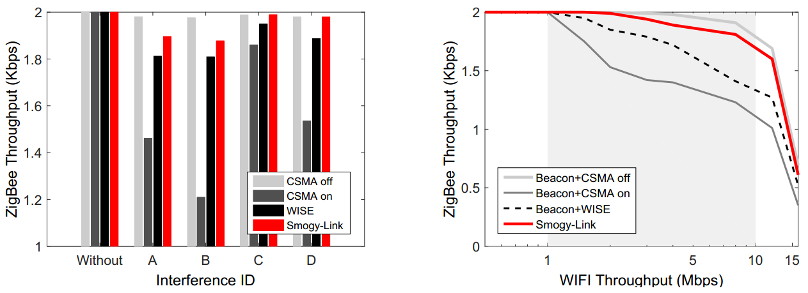
Throughput
40%
Throughput of Smogy-Link only decreases slightly even under high power interference
Smogy-Link achieves high throughput when WiFi data rate ≤10Mbps
Notes:
These two figures show the performance on throughput.
We can observe that, the Throughput of Smogy-Link only decreases slightly even under high power interference
Compared with the interference avoidance methods, Smoggy-Link can improve the throughput by 40%.
In addition, we also evalueate the impact of WiFi data rate on ZigBee throughput,
The result shows that, Smoggy-Link achieves high throughput when the data rate is lower than 10Mbps.
When the data rate is higher than 10Mbps, all the four methods suffers serious throughput decline.
This is because transmission technology with CSMA disabled can maximally exploit the concurrent opportunities by completely turn off the CSMA, which however leads to poor PRR and thus high energy consumption for packet retransmissions.

Slide 22
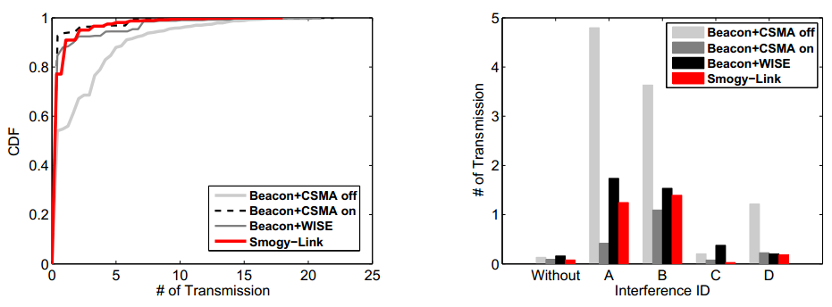
Retransmission
Comparable with
avoidance approaches
Even under high power interference
Retransmission count of Smoggy-Link is comparable with that of interference avoidance approaches.
Retransmission count is controlled under 2 even under harsh interference.
Notes:
Then let's look at the performance on Retransmission.
We can see that, Although concurrent transmission is adopted in Smoggy-Link, its retransmission count is comparable with that of interference avoidance approaches.
In addition, even under high power interference, the transmission count of Smoggy-Link is controlled under 2 times.

Slide 23
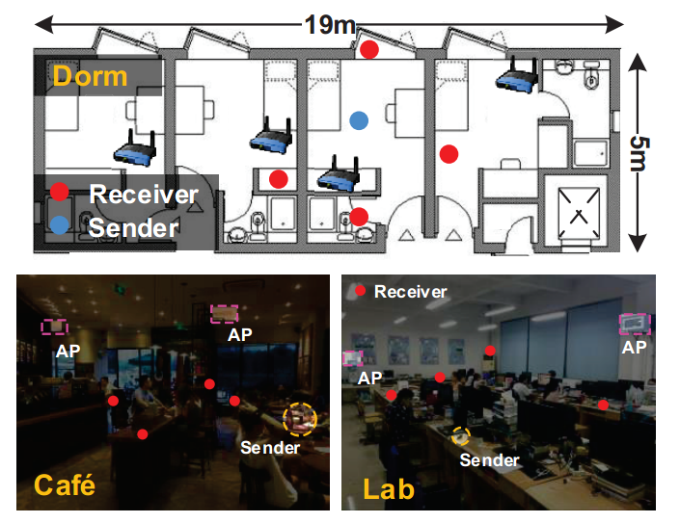
Real World Experiment
Notes:
We also conduct experiments under practical environment in our lab, a dorm and a cafe

Slide 24
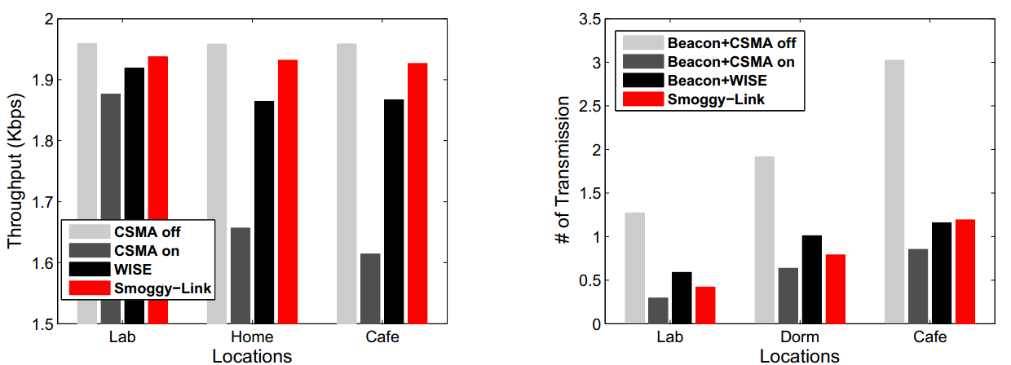
Real World Experiment
Throughput
Retransmission
Lab Dorm Cafe
Locations
Smoggy-Link’s performance gain is more significant in the cafe and dorm than that in the lab.
Notes:
These two figures show the performance on throughput and retransmission
We can see that Smoggy-Link’s performance gain is more significant in the café and dorm than that in the lab.
This is because that the degree of wireless interference in cafe and dorm is much higher than that in the lab

Slide 25
Conclusion
We propose Smoggy-Link to exploit potential concurrency for adaptive transmission under interference.
Interference identification
Link model
Link selection and transmission schedule
Real implementation of Smoggy-Link in TinyOS2.1.1
Evaluation in under practical environment
Notes:
In conclusion, we propose Smoggy-Link to exploit potential concurrency for adaptive transmission under interference..
To achieve this goal, we propose a method to identify different interference based on their RSSI patterns.
We also propose a link model to translate the low-cost interference information to fine-graind link information.
As last, a transmission method is proposed for link selection and transmission schedule.
We implement Smoggy-Link in TinyOS and evaluate its performance under practical environment .
conduct evaluation in indoor testbed to test the performance of Smoggy-Link.

Slide 26


Meng Jin
mengj@stumail.nwu.edu.cn
Notes:
Thank you so much for your attention, I’m happy to take your question.
Scope:
Smoggy-Link adopts a best effort design.
When there is no interference or when the interference is too strong and there didn’t have any chance for concurrent transmission, the Smoggy-Link act as a conventional Zigbee.
Concurrency with ZigBee
Handling of the ZigBee interferences is similar with other interferences (i.e. WIFI and Bluetooth) except the identification process.
Specifically, when a ZigBee interference is detected, a node can directly identify the transmitter through
overhearing

Slide 27
Backups

Slide 28
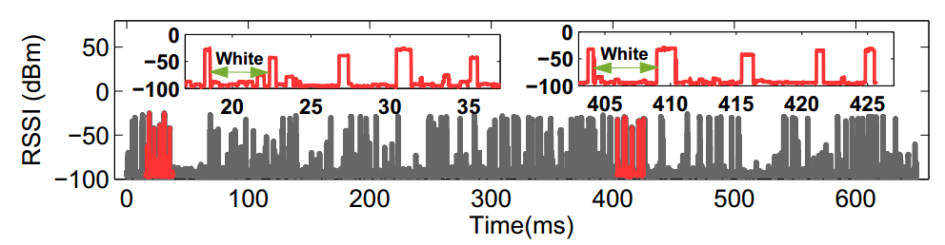
Periodic White/Black Space
RSSI Sequence of Wi-Fi
RSSI Sequence of Bluetooth
Notes:
Indeed, in addition to the WIFI, we also conduct experiment for Bluetooth transmission.
And we find that the result is similar with that of WIFI.
This result is consistent with the observations in some recent works

Slide 29
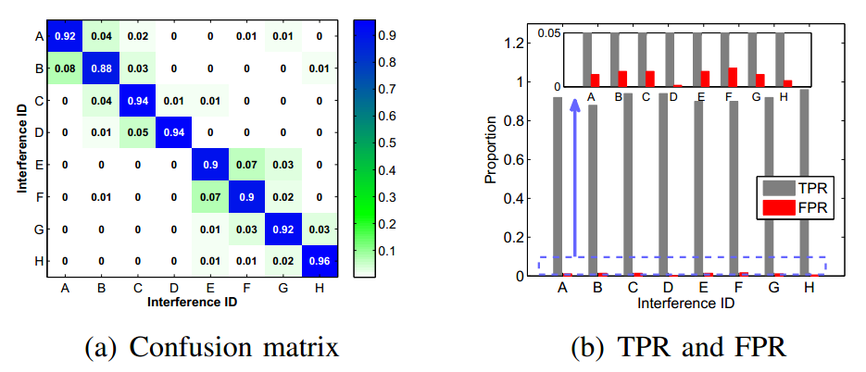
Interference Identification
Average TPR: 92%
FPR: from 0.14% to 1.71%
The average identification accuracy is 92% with a standard deviation of 2.6%
FPRs for identifying all interference are ranging from 0.14% to 1.71%, with an average of 1.13%.
Notes:
Indeed, we also evaluate the performance of the interference identification component.
In the experiment, we put a node in an environment in presence of 8 different interference.
The interferers take turn to generate interference signals, during which the node collects the RSSI segments
of the ongoing interference and identify it
The experiment result is shown in these two figures.
We can see that,….
The above results show that our interference identification method can distinguish a set of interferences with high accuracy by using only RSSI segments.
In the experiment, we put a node in an environment in presence of 8 different interferers.
The interferers take turn to generate interference for 10 min individually,
during this time the node collects the RSSI segments of the ongoing interference and identify it.
The result is shown in these two figures.
We can obsrve that, ,,,,

Slide 30
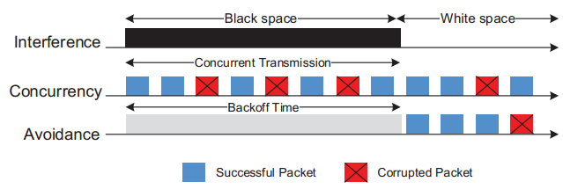
Concurrent transmission improves the throughput but suffer from low PRR and thus poor energy efficiency.
Backoff transmission brings better PRR but suffers from poor throughput.
Benefit-driven transmission: enables a sender to estimate the expect
benefit and energy efficiency for concurrent and backoff transmission, then makes a wise choice between them.
Notes:
This figure shows the Channel utilization and packet reception rate for concurrent transmission and backoff transmission.
As shown in this figure, concurrent transmission improves the throughput but suffer from low PRR and thus poor energy efficiency.
Backoff transmission gives the packet an independent chance of delivery, which brings better PRR but suffers from poor throughput.
So in this work, we propose a benefit-driven transmission method, which enables a sender to estimate the expect benefit and energy efficiency for concurrent and back off transmission, then make a wise choice between them.

Slide 31
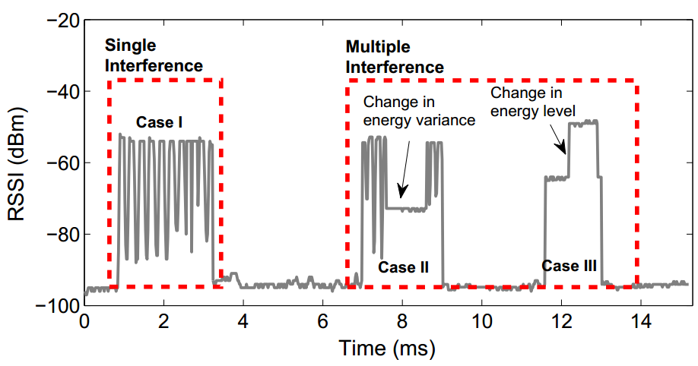
Example of RSSI segments with single or multiple interferences
Dorm | Lab | Cafe
3.24 % | 1.26 % | 7.58 %
Notes:
When mutiple interference generate interference concurrently, their signal will overlap in the air.
In this senario, the node can hardly identify the interference and thus it can not select the best outbound link.
Thus it has to back off to avoid the interference.
Fortunately, due to the CSMA technology, the probability of multiple interference is very low.
We conduct some experiment in some representative real-world environment: the lab, the café and the dorm, and this table shows the probability of multiple interference in different environment.
We can see that the probability in the dorm/lab environment is less than 4%, which means Smoggy-Link has more than 96% chance for concurrent transmissions in such environment.
Even in the cafe, where the wireless environment is very crowded, Smoggy-Link can also find more than 92% chance for concurrent transmission.

Slide 32

Handling mobile interferences
……
……
Notes:
Smoggy-Link can also handle mobile interferences.
Indeed, if an interferer is moved, its fingerprint, as well as its impact on the links would change.
Thus the identification component would treat it as a new interference.
In addition, we believe that the interference from the mobile device would have little impact on ZigBee.
This is because that the data traffic generated by mobile devices is much smaller than that generated by the stationary WIFI Aps.
Since the mobile device generate upstream data traffic used only for online chatting or sending a email and so on.
However, the WiFi Ap generate the downstream data traffic that used for dowloading movie and so on.
So compared with the impact from the stationary device, the impact from the mobile device is very low.
On another hand, in most scenarios, such as in the office, cafe, or library, the location of mobile devices are usually fixed (such as on the seat of the user).
Small location change (such as pick up from the table) is tolerable since itincurs little changes in the fingerprint and the link quality.

Slide 33
Impact of ZigBee on other technologies
Wi-Fi:
Wi-Fi
Sender
Receiver
Notes:
Let me show that the impact of Smoggy-link on WiFi and Bluetooth is limited and tolerate.
Let’s first look at WiFi
In the design of Smoggy-Link, the most important condition for concurrency is exposed terminal, namely the
interferer is located within the CCA range of ZigBee sender but outside the interference range of ZigBee receiver.
Thus if concurrency is permitted, there is a strong possibility that the sender is located at the boundary of
the communication range of the Wi-Fi interferer.
In addition, since the transmit power of Wi-Fi devices is much higher than that of ZigBee, the communication range of Wi-Fi is much broader than that of ZigBee.
Thus we can infer that the Wi-Fi interferer is probably located outside the interference range of the ZigBee sender and thus the transmission of ZigBee would have little impact on the performance of Wi-Fi.

Slide 34
Impact of ZigBee on other technologies
Bluetooth:
Frequent Hopping
Notes:
Then let’s talk about bluetooth.
Bluetooth uses the frequency hopping technique
The hopping occurs at a rate of 1600 hops/s, hence it occupies one channel for only 625 µs.
This improves its robustness against the interference from other technologies.
In addition, since Bluetooth spans over the whole 2.4 GHz ISM band while the ZigBee only occupies a 2MHz channel during transmissions, this implies that ZigBee would have little impact on Bluetooth during the concurrency.

Slide 35
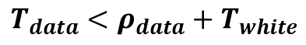
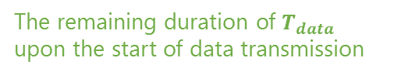
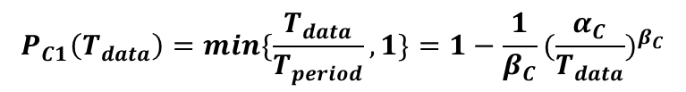
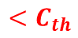
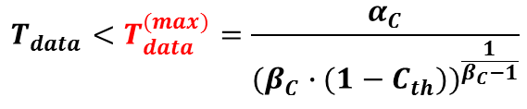
Limiting the length of data period in the current white/black period:
Length of data period $T_{data}$ must satisfies that:
$$T_{data}<ρ_{data}+T_{white}$$
The remaining duration of $T_{data}$ upon the start of data transmission
Assume that $ρ_{data}$ is uniformly distributed over the black space, the probability of C1 is:
$$P_{C1}\left(T_{data}\right)=min\{\frac{T_{data}}{T_{period}},1\}=1−\frac{1}{β_{C}}{(\frac{α_{C}}{T_{data}})}^{β_{C}}$$
A predefined threshold
$$<C_{th}$$
$$T_{data}<T_{data}^{(max)}=\frac{α_{C}}{{(β_{C}∙(1−C_{th}))}^{\frac{1}{β_{C}−1}}}$$
Notes:
Now, first let me show how to avoid the collision between ACK and the next black space.
As shown in this figure, to avoid this collision, the data period Tdata should be shorter than rou data plus Twhite,
Here, rou data is the remaining duration of the data period upon the start of data transmission
Then Assume that rou data is uniformly distributed over the black space, the probability of collision can be given as the smaller one between 1 and the ratio of Tdata and Tperiod.
Then Based on the Pareto model, the espected Probability of C1 is given as this .
Then, Given a specific probability threshold Cth, the length of data period must satisfies this equation.
Therefore, before a sender starts a sending task, it should first compare the required Tdata with the estimated T data max
If Tdata is longer than the Tdata Max, the sender has to reduce the packet number in the current period utile this equation is satisfied.

Slide 36
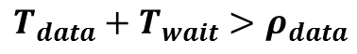
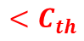
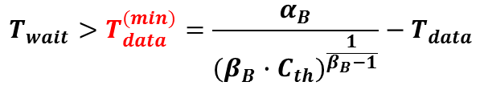
Adjusting the arrive time of the ACK:
The sender has to estimate the arrive time of the next white space, and notifies the receiver to wait $T_{wait}$before replying the ACKs.
$$T_{data}+T_{wait}>ρ_{data}$$
Based on the Pareto model, the probability of C2 is:
$$P_{C2}\left(T_{wait}\right)=min\{\frac{T_{black}−(T_{data}+T_{wait}) }{T_{black}},1\}=\frac{1}{β_{B}}{(\frac{α_{B}}{{T_{wait}+T}_{data}})}^{β_{B}−1}$$
$$<C_{th}$$
$$T_{wait}>T_{data}^{(min)}=\frac{α_{B}}{{(β_{B}∙C_{th})}^{\frac{1}{β_{B}−1}}}−T_{data}$$
Notes:
Then the next step is to Adjust the arrive time of ACK.
That is the sender has to estimate the arrive time of the next white space, and notifies the receiver to wait $T_{wait}$before replying the ACKs.
Specifically, the Twait should satisfied that Tdata plus Twait is longer than rou data.
Similarity, based on the Pareto model, the probability of this collision should satisfy this equation.
Then, given a threshold Cth, the Twait should satisfy this equation.

Slide 37
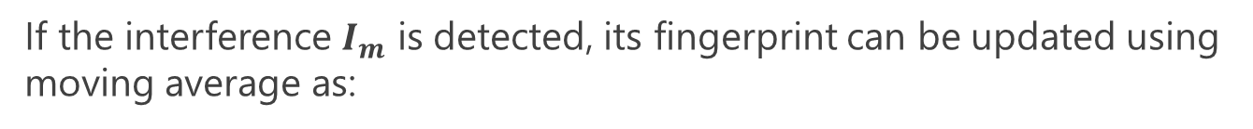
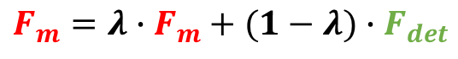
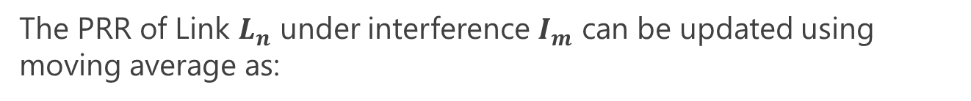
Update fingerprint table:
If the interference $I_{m}$ is detected, its fingerprint can be updated using moving average as:
$$F_{m}=λ∙F_{m}+(1−λ)∙F_{det}$$
where $λ=0.9$
Update LinkMap:
The PRR of Link $L_{n}$ under interference $I_{m}$ can be updated using moving average as:
$${prr}_{S,L_{n}}^{I_{m}}=λ∙{prr}_{S,L_{n}}^{I_{m}}+(1−θ)∙{prr}_{S,L_{n}}^{I_{m−new}}$$
where $θ=0.9$
Notes:
If the interference $I_{m}$ is detected, its fingerprint can be updated using moving average as:
Where lambda is a adjustable parameter which is set as 0.9 in our implementation
If the sender selects Link $L_{n}$ as the best link and transmits a series of packets through $L_{n}$ under a certain interference $I_{m}$, it would obtain a new PRR for this transmission task, then the PRR of Link $L_{n}$ under interference $I_{m}$ can be updated using moving average as:
Where theta is a adjustable parameter which is set as 0.9 in our implementation

